Slide 1
dot in space

Slide 2
Цел на проекта

Slide 3
Проблемът и настоящите решения

Slide 4
Нашето решение.

Slide 5








Технологии

Slide 6







Технологии

Slide 7
Как работи?
F.E.
Mars is a
cold place
AI
API
Pluto is now a dwarf planet
Mercury is the closest planet to the Sun
APP
Pluto is now a dwarf planet

Slide 8
Как работи?
Per
F.E.
Pluto is now a dwarf planet
Mars is a
cold place
AI
Pluto is now a dwarf planet
API
APP
Mercury is the closest planet to the Sun
Pluto is now a dwarf planet

Slide 9
Процесът на разработка

Slide 10
Процесът на разработка
Петък
Неделя
Despite being red, Mars is a cold place
Venus has a beautiful name
DAY 01
DAY 02
DAY 03
DAY 04
DAY 05
Четвъртък
Събота
Бъдещо
It’s the biggest planet in the Solar System
Mercury is the smallest of them all
Saturn is the ringed one and a gas giant

Slide 11
Place your screenshot here

Slide 12
Notes:
TestDrive

Slide 13
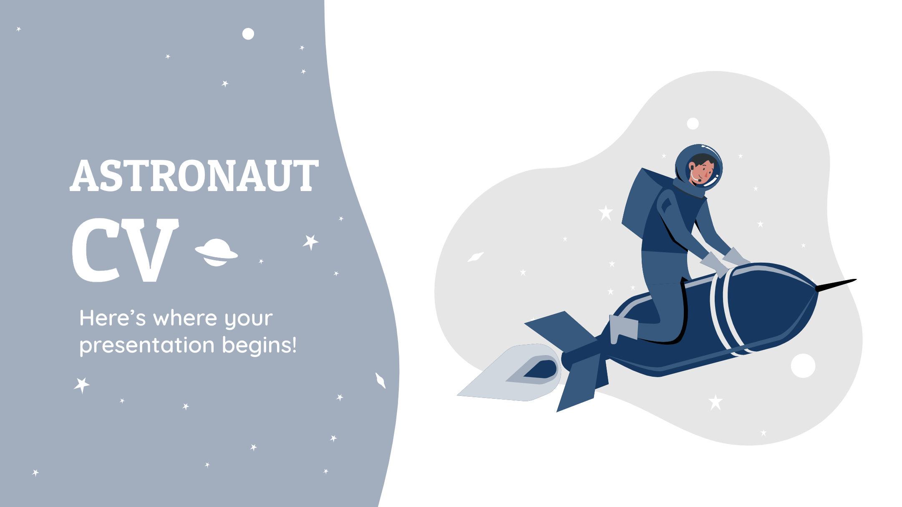

Slide 14
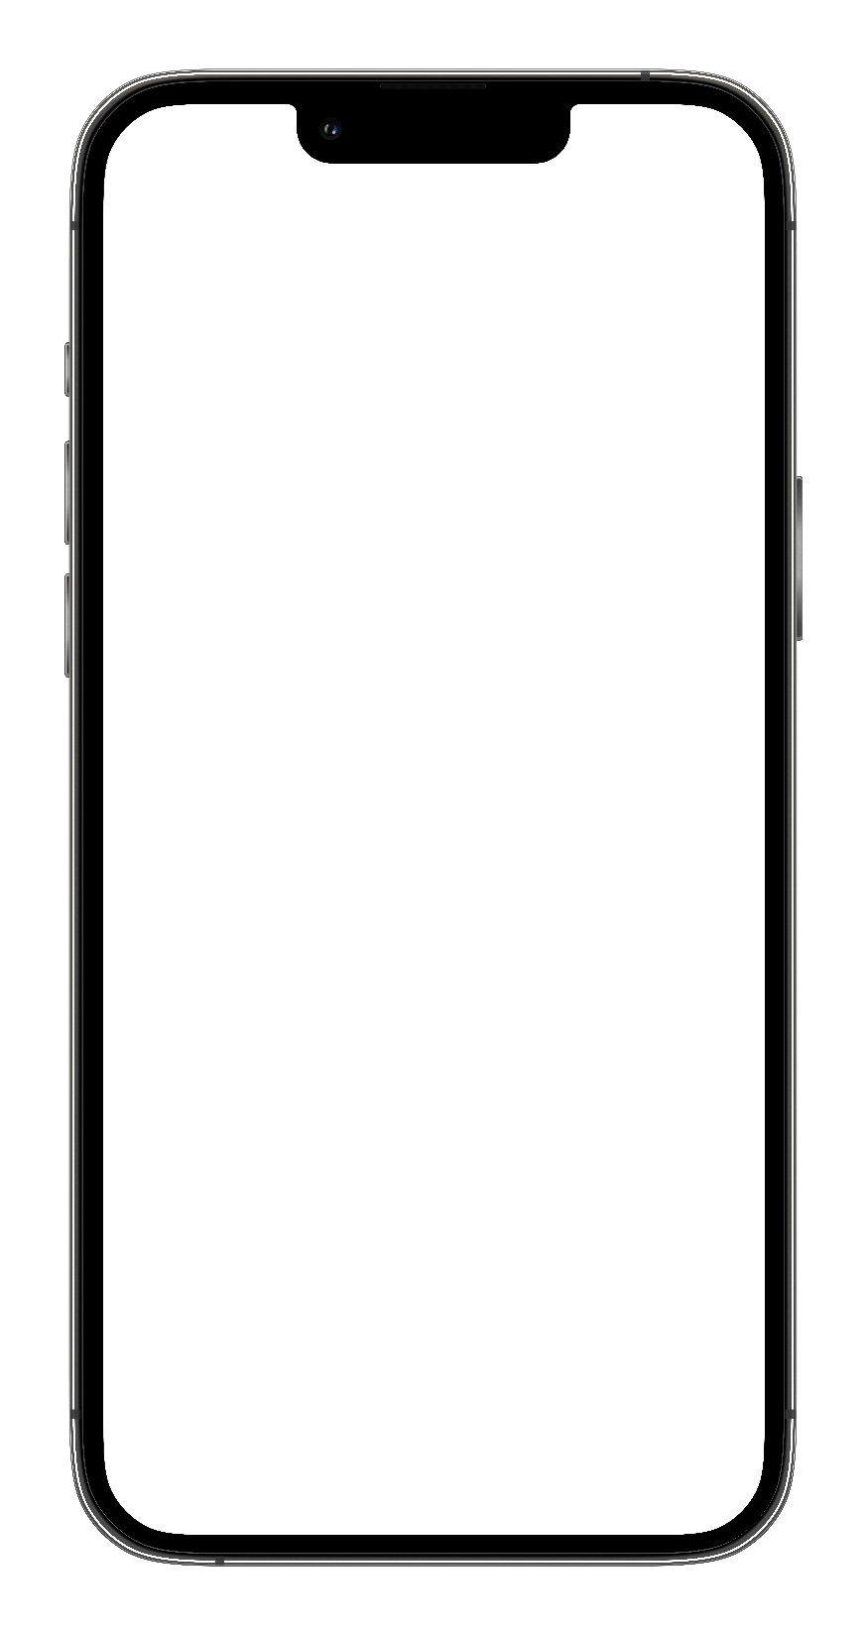
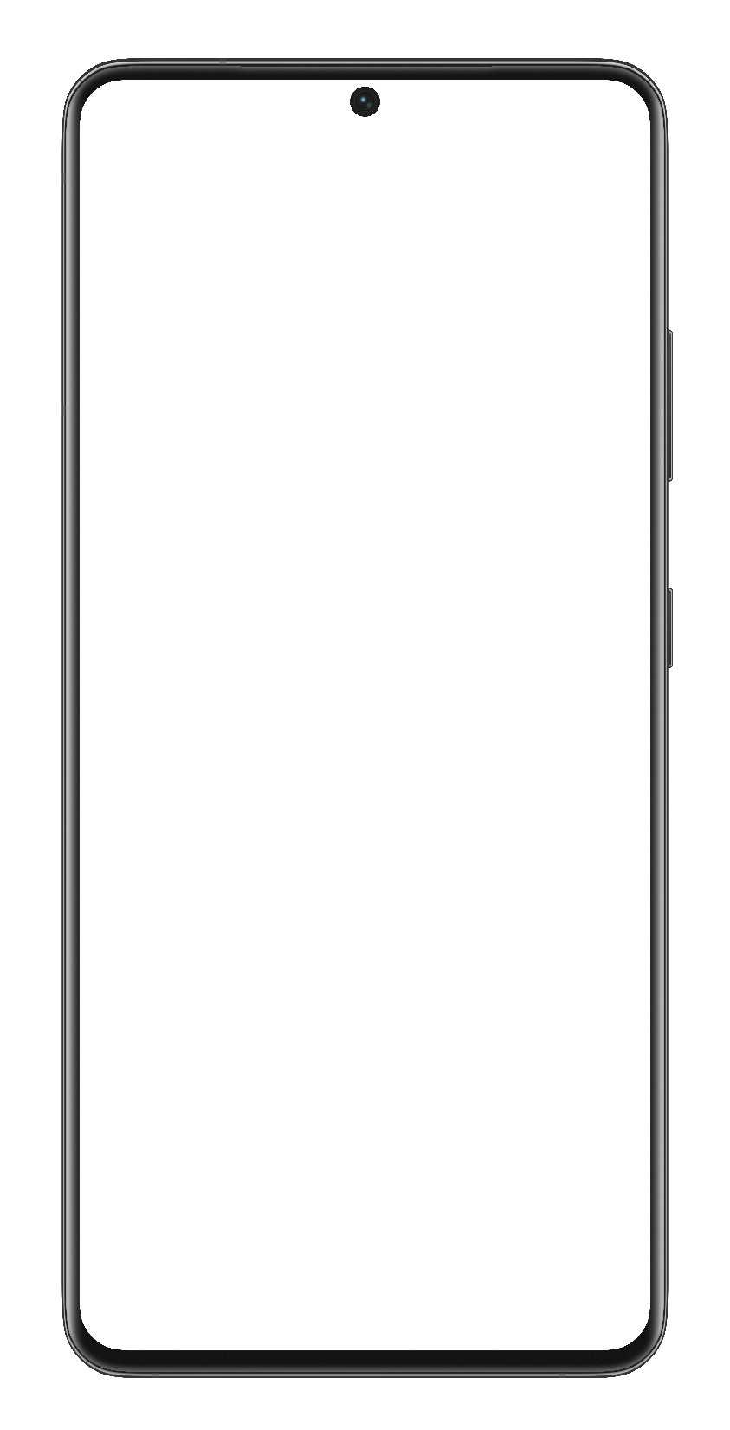
Notes:
iPhone 13 Pro Max 4x
Samsung S21 Ultra 5G 4x

Slide 15
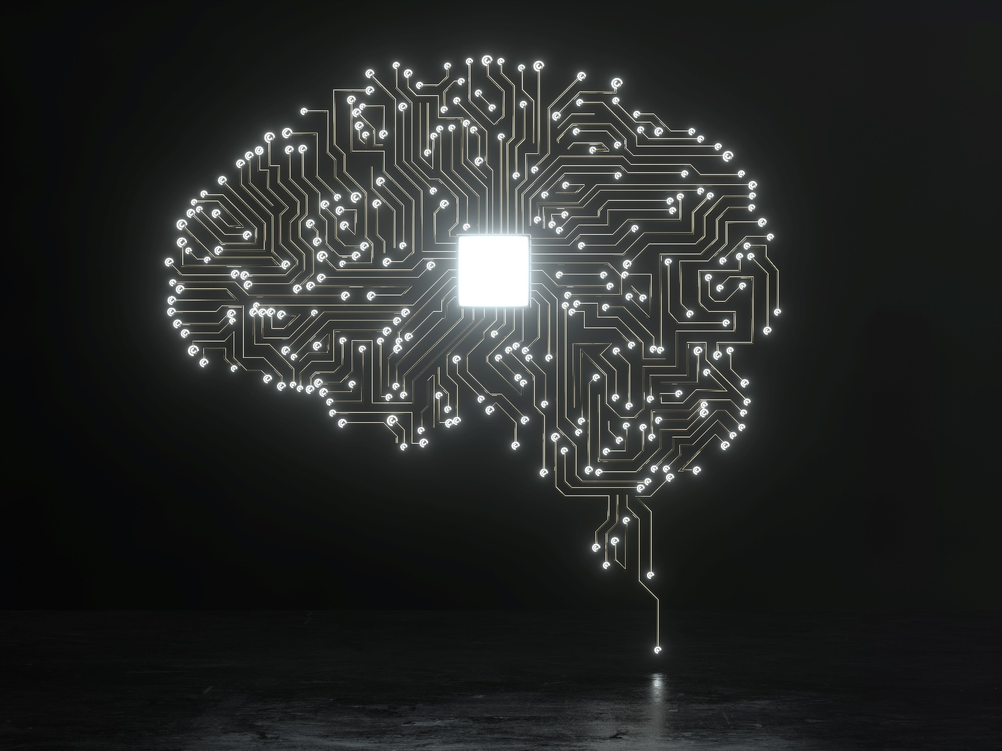
Разкажете за Вашето преживяване
Какво научихте от хакатона?
Кой е вашият екип?
Кой е вашият ментор?
…..

Slide 16
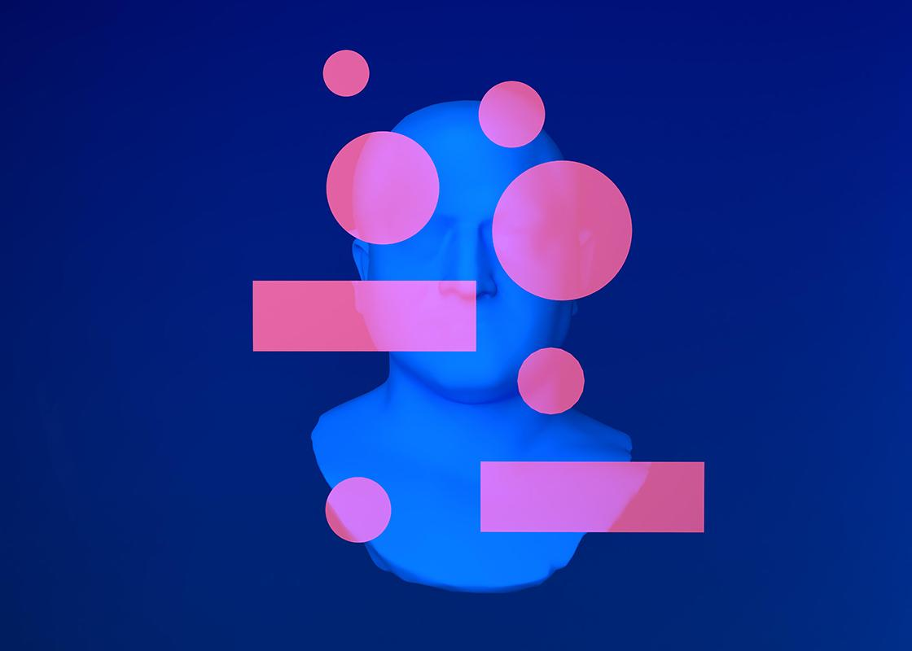
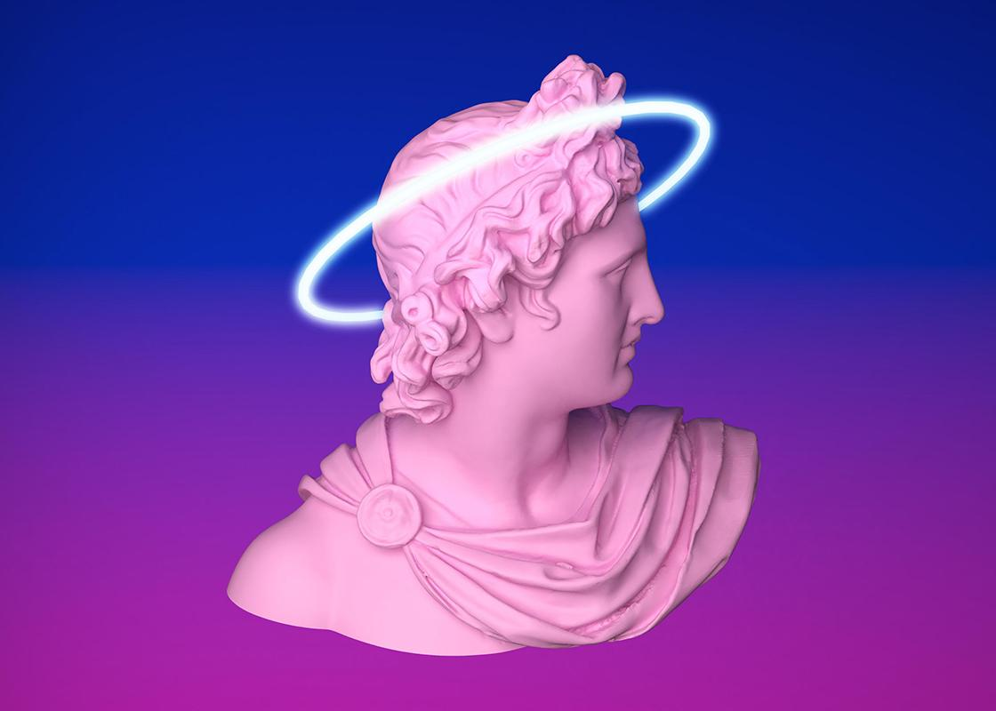

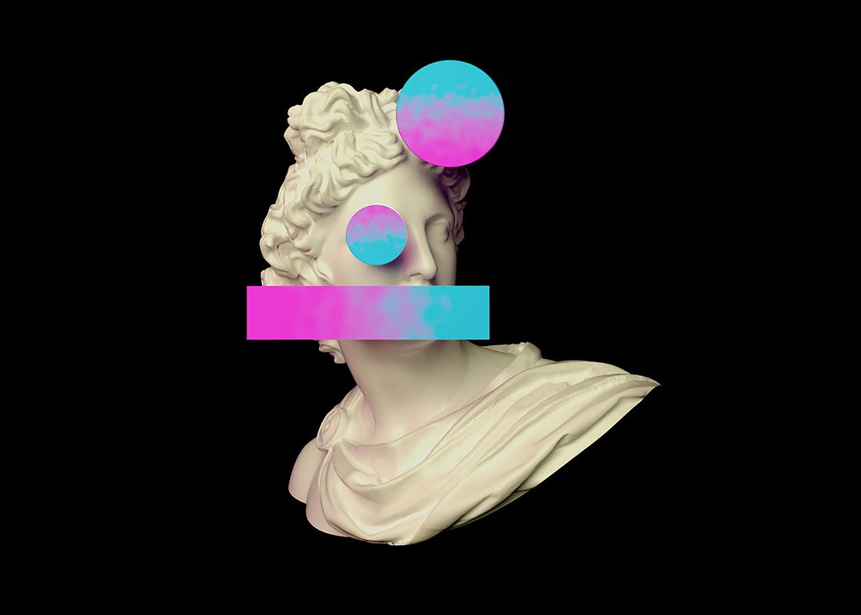
Our team
Алеко
Мартин
Кристиян
You can describe your team member here
You can describe your team member here
You can describe your team member here

Slide 17
Our team
Александър
Калоян
Ангел
You can describe your team member here
You can describe your team member here
You can describe your team member here

Slide 18
Благодаря за вниманието!
Петър беше тук

Slide 19



Dumpster dive

